Slide 1


Slide 2
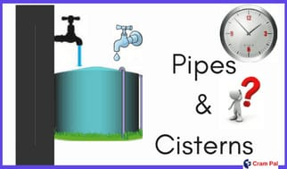

Slide 3
(1) Two pipes can fill a tank in 10 hours and 12 hours respectively while a third pipe empties the full tank in 20 hours. If all the three pipes operate simultaneously, in how much will the tank be filled?
(a) 6 hr 30 min (b) 7 hr 30 min
(c) 8 hr (d) 8 hr 45 min

Slide 4
Two pipes A and B can fill a tank in 20 and 30 minutes respectively. If both the pipes are used together, then how long will it take to fill the tank ?
(a) 12 min (b) 15 min
(c) 25 min (d) 50 min

Slide 5
(3) Pipe A can fill a tank in 5 hours, pipe B in 10 hours and pipe C in 30 hours. If all the pipes are open, in how many hours will the tank be filled ?
(a) 2 (b) 2.5
(c) 3 (d) 3.5

Slide 6
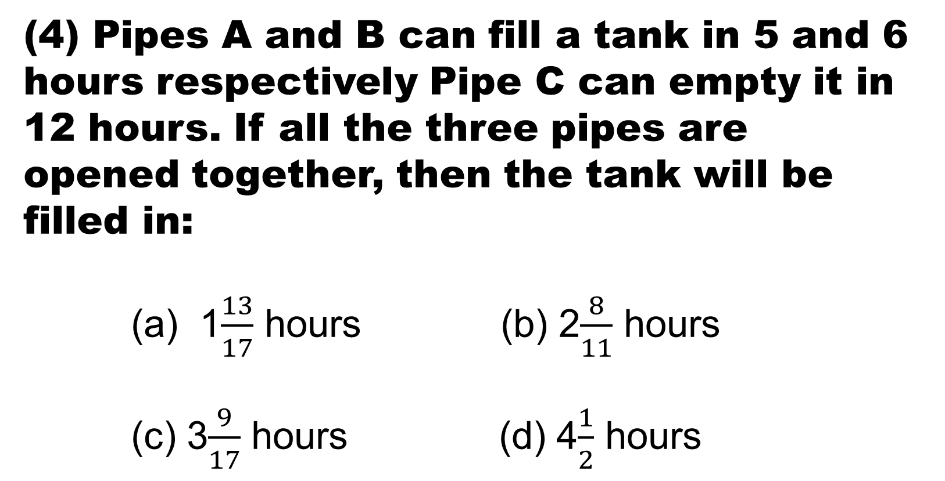
(4) Pipes A and B can fill a tank in 5 and 6 hours respectively Pipe C can empty it in 12 hours. If all the three pipes are opened together, then the tank will be filled in:
(a) 1$\frac{13}{17}$ hours (b) 2$\frac{8}{11}$ hours
(c) 3$\frac{9}{17}$ hours (d) 4$\frac{1}{2}$ hours

Slide 7
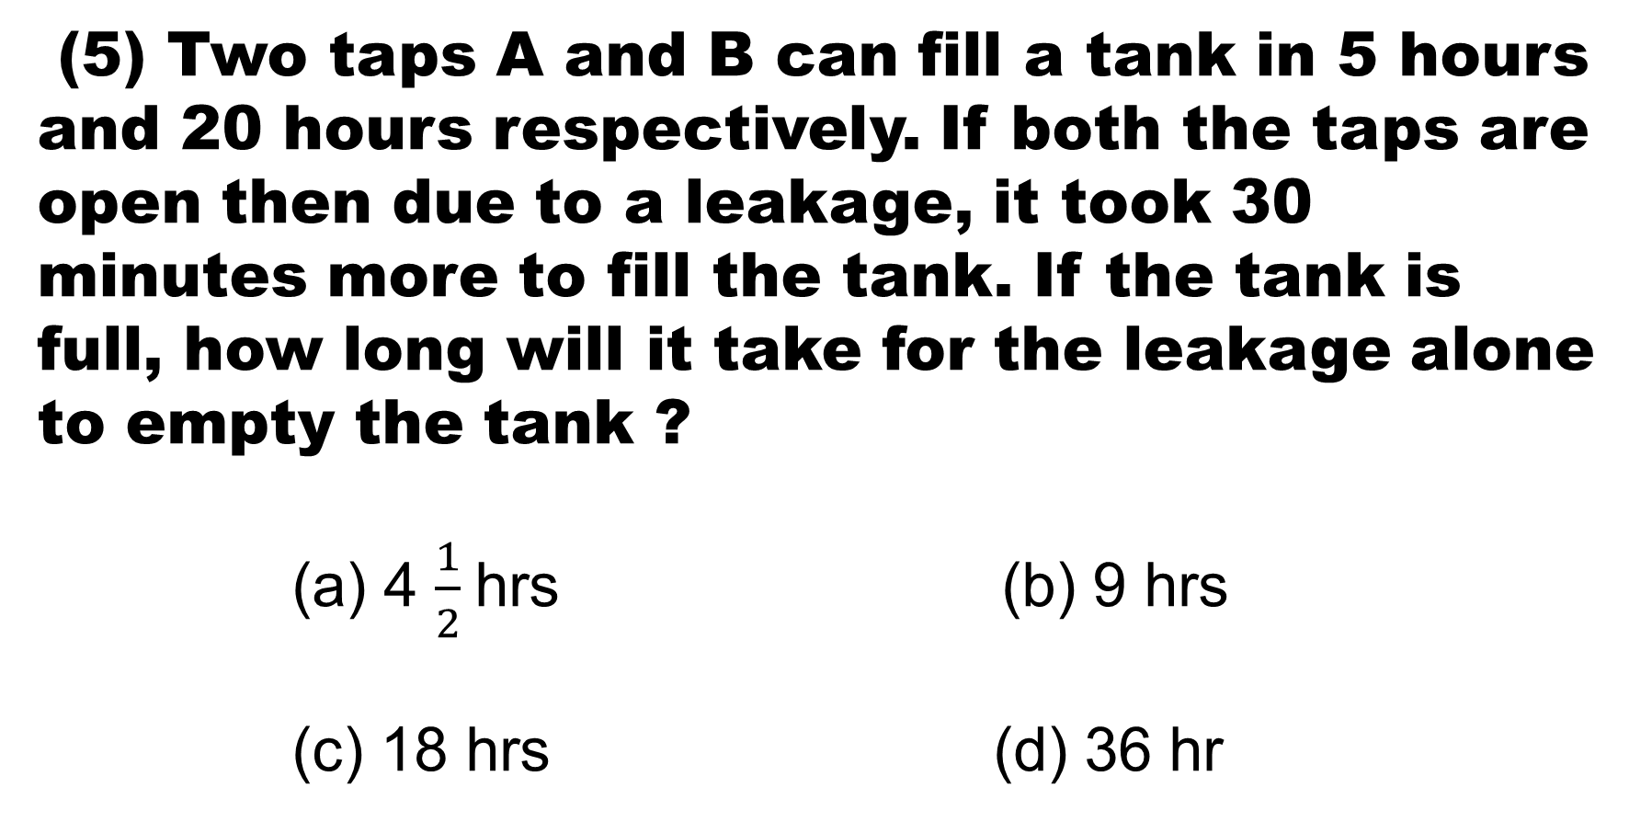
(5) Two taps A and B can fill a tank in 5 hours and 20 hours respectively. If both the taps are open then due to a leakage, it took 30 minutes more to fill the tank. If the tank is full, how long will it take for the leakage alone to empty the tank ?
(a) 4 $\frac{1}{2}$hrs (b) 9 hrs
(c) 18 hrs (d) 36 hr

Slide 8
(6) Two pipes A and B together can fill a cistern in 4 hours. Had they been opened separately, then B would have taken 6 hours more than A to fill the cistern. How much time will be taken by A to fill the cistern separately ?
(a) 1 hr (b) 2 hrs
(c) 6 hrs (d) 8 hrs

Slide 9
(7) One pipe can fill a tank three times as fast as another pipe. If together the two pipes can fill the tank in 36 minutes, then the slower pipe alone will be able to fill the tank
(a) 81 min (b) 108 min
(c) 144 min (d) 192 min

Slide 10
(8) A tank is filled in 5 hours by three pipes A, B and C. The pipe C is twice as fast as B and B is twice as fast as A. How much time will pipe A alone take to fill the tank?
(a) 20 hrs (b) 25 hrs
(c) 35 hr (d) None of these

Slide 11
(9) A tank is filled by three pipes with uniform flow The first two pipes operating simultaneously fill the tank in the same time during which the tank is filled by the third pipe alone. The second pipe fills the tank 5 hours faster than the first pipe and 4 hours slower than the third pipe. The time required by the first pipe is :
(a) 6 hrs (b) 10 hrs
(c)15 hrs (d) 30 hrs

Slide 12
(10) 12 buckets of water fill a tank when the capacity of each tank is 13.5 lit. How many buckets will be needed to fill the same tank, if the capacity of each bucket is 9 lit ?
(a) 8 (b) 15
(c) 16 (d) 18

Slide 13


